Slide 1
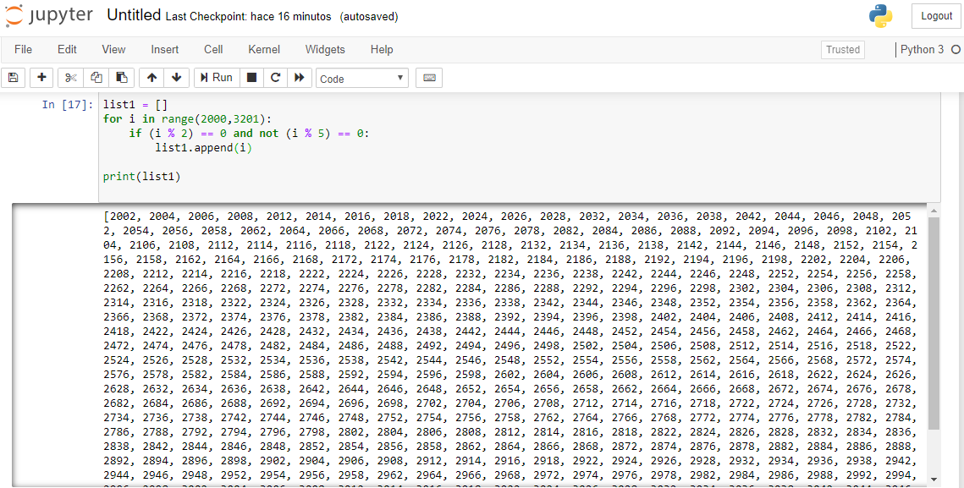
Exercise 1

Slide 2

Exercise 2

Slide 3

Exercise 3

